Slide 1
SAHP Scheduler
The Stay-At-Home-Parent’s organizational tool!

Slide 2
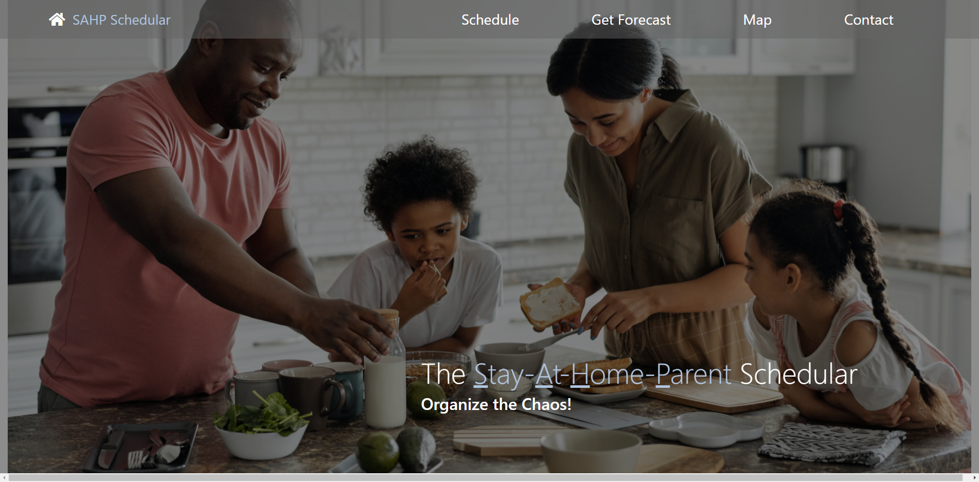
Elevator pitch

Slide 3
Concept
The SAHP Calendar is a web-based task scheduler with the features to layout daily appointments and simultaneously gather the pertinent information that may affect the fulfillment each obligation.
This website was developed after witnessing the complex schedules many SAHPs are required to orchestrate on a daily basis.
As a busy parent/guardian, I find it extremely difficult to plan a daily schedule that keeps track of the various personal and family appointments while factoring in all the variables that can affect travel time or contents needed due to ever changing conditions. I WANT a single scheduling site where I can gather all pertinent information, SO I CAN be more efficient with my scheduling, getting to appointments on time, and have peace of mind knowing it is all organized in a single place.

Slide 4
Process
Technologies: HTML, CSS, Javascript and Jquery.
Contributions:
Scott created the general HTML layout and styling for the navigation bar, header, and footer along with updating Alex’s scheduler with time display and content interaction with momentJS.
Alex was responsible for the schedule and map sections, and the serverside API functions for the map and the weather.
Berk created a modal that requested the user’s city and displayed the forecast in the weather section. He also did all the final touches in fixing some responsiveness issues and adding some additional buttons.
Challenges that we faced include learning how to manage our pull requests and merges, making the application responsive, and making the weather forecast persist upon page reload.
Successes included using mulitple APIs. Such as, the ability to get driving directions, displaying current time and fetching weather for any location. We were also succeful in creating a modal that requested the user to input their city in order to generate their forecast.

Slide 5
Demo

Slide 6
Directions for Future Development
Integration of calendar events into other personal calendars, i.e. Outlook, Google Calendar, iOS Calendar, etc.
Multi day future scheduling.
Automatic notifications of approaching events or appointments.
Traffic routing automatically provided to appointment locations.
Updated travel time notifications due to traffic or weather changes.
Forecast persists through page reload.

Slide 7
Links
Deployed: https://sessions21.github.io/Project1-SAHM-Calendar/
GitHub repo: https://github.com/Sessions21/Project1-SAHM-Calendar.git

